Slide 1

Wellness Center Appointment Services

Slide 2

Team members
Rehaman Naguru Abdur
Reshma Reddy Sunkireddy
Chaitanya Punaati
Hitesh Reddy Tirumala Reddy
Pulugurtha Vinay Madhur
Swapna Dasari

Slide 3
Contents
Motivation
UI Design
Technologies used
Home Page
Booking Appointment
Profile page
Firebase Database
Challenges faced
Conclusion

Slide 4
Motivation
There is no proper application/website for our university wellness center.
Not everyone are aware about the services they provide.
There is no tool to track health records.
Notes:
Our university wellness center provides many services to make sure everyone is healthy. It is one of the great opportunity our university provides to us, but the challenge here is when we want to know what all the features are it is offering and when we want to book an appointment the only option, we have is either to call or email. There is no website or application for this. So, we would like to implement a website and do our best to help our university students/faculty/staff.

Slide 5
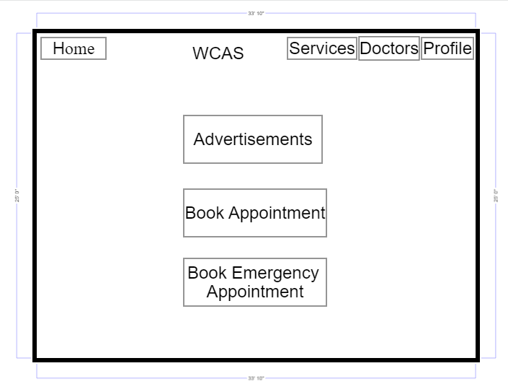
UI Design
Notes:
This is the Home page of our website which you will see after sign into this website. WCAS is our website title which means wellness center appointment services.
Services – This page displays the info about all the services provided by wellness center.
Doctors – This page displays the doctors info like how many doctors are available, what is their field etc.,
Profile – User health history is available along with logout option.
Advertisements – Display the info about ongoing drives like blood camp, vaccination drive etc.,
Book appointment – to book a general appointment with the flexible date and doctor.
Book emergency appointment – to book an emergency appointment. No datas will be available to select because you will be treated on priority basis.

Slide 6

Technologies Used
Languages
CSS
React JS
Node JS
Firebase
Platforms
Microsoft Visual Studio
GitHub
Notes:
Why react js among other?
Why firebase among other?

Slide 7
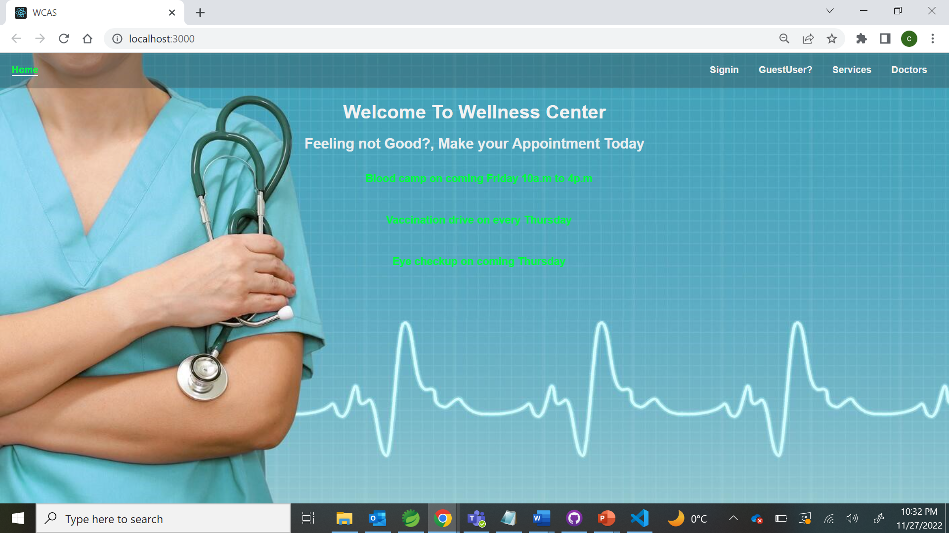
Home Page
Notes:
This is the home page of our website which looks before sign in.
On the top right, you have an option to register and sign into this page.
Services, doctors page[s and advertisements will be visible even without signin to the website.

Slide 8
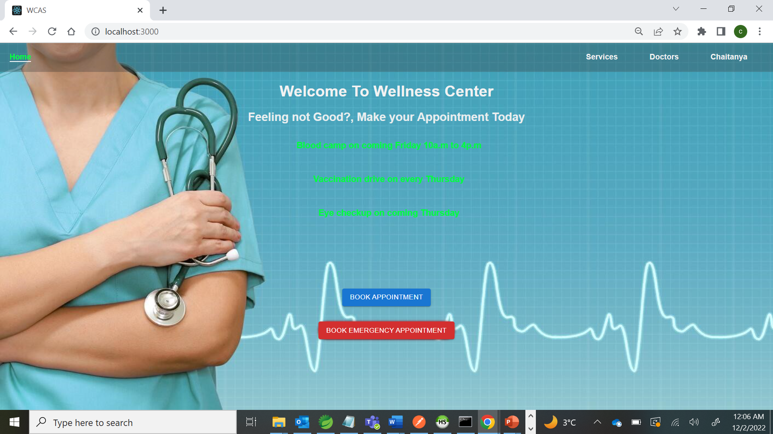
Notes:
And once you have signin to the website it will look like this. Here you will an option to book general and emergency appointments. Also you will have your profile page where you can find your health records.

Slide 9
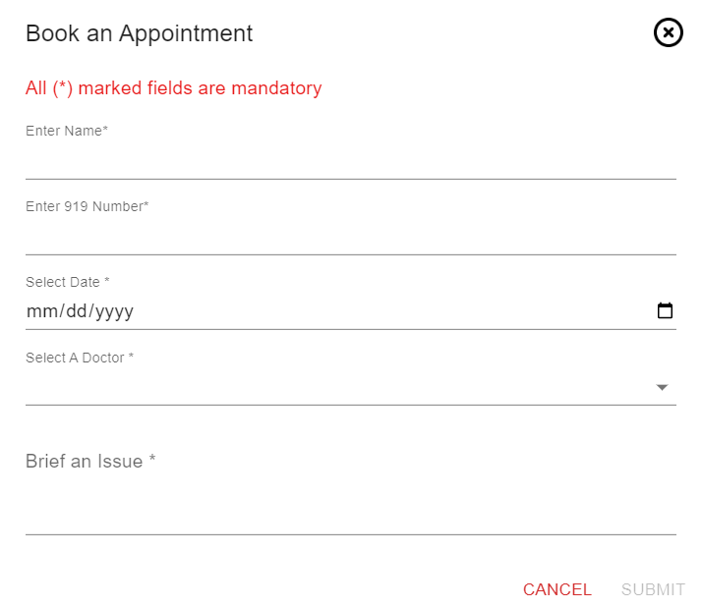
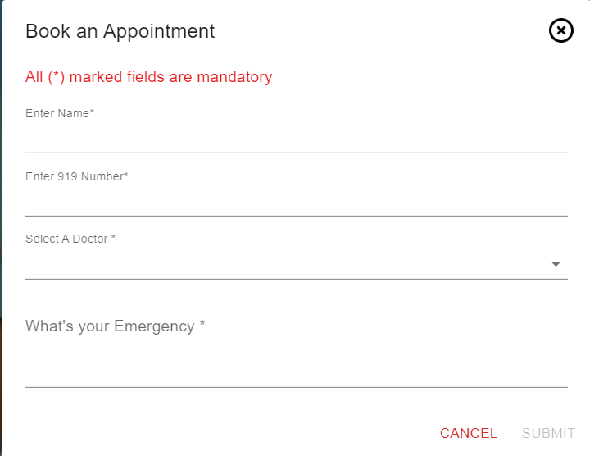
Booking Appointment
General Appointment
Emergency Appointment
Notes:
This is the booking appointment page.
Left side one is booking a general appointment. Here you can select which day you want an appointment and which doctor you want to meet.
Right side one is booking an emergency appointment. Here you can just enter you details and select doctor. Once you submit you will get a priority based appointment.

Slide 10
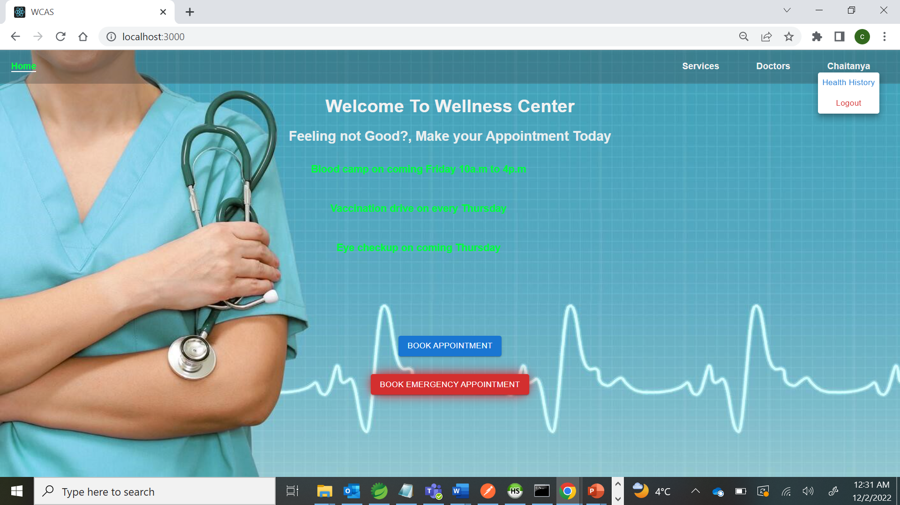
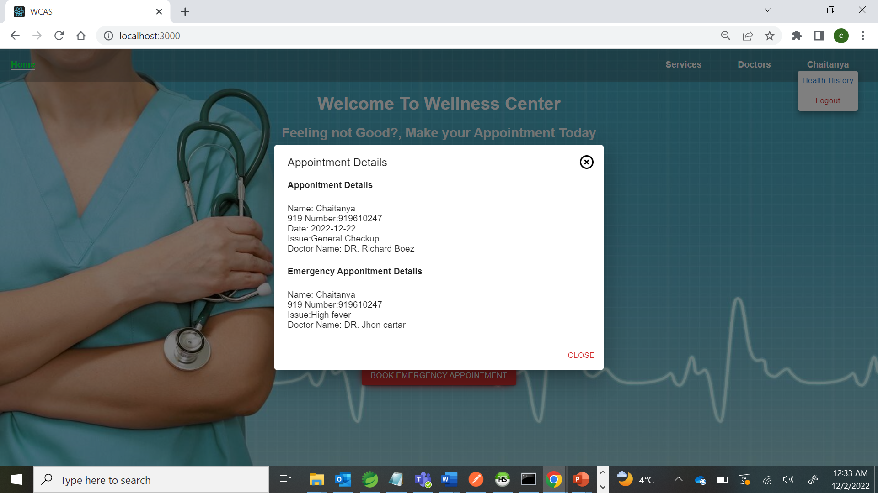
Profile Page
User can view their health history
Notes:
This is the profile page of user. You will have a option to redirect to your health history records. And once it is redirected it will looks like in the below screenshot.

Slide 11
Firebase Database
NoSQL cloud database.
Cross platform.
Customize monitoring for your app
We have used Firebase Authentication & Firebase Real time database.

Slide 12
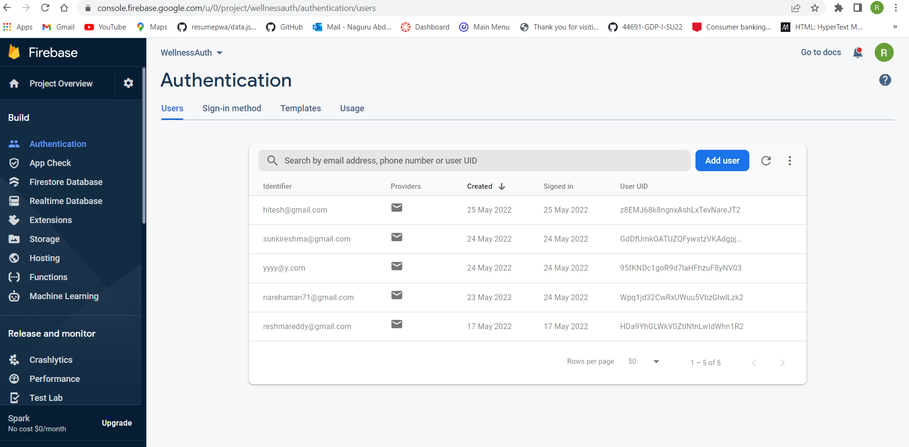
Used firebase Authentication for storing emails and passwords of the users and validating in Login Page.
Firebase Authentication

Slide 13
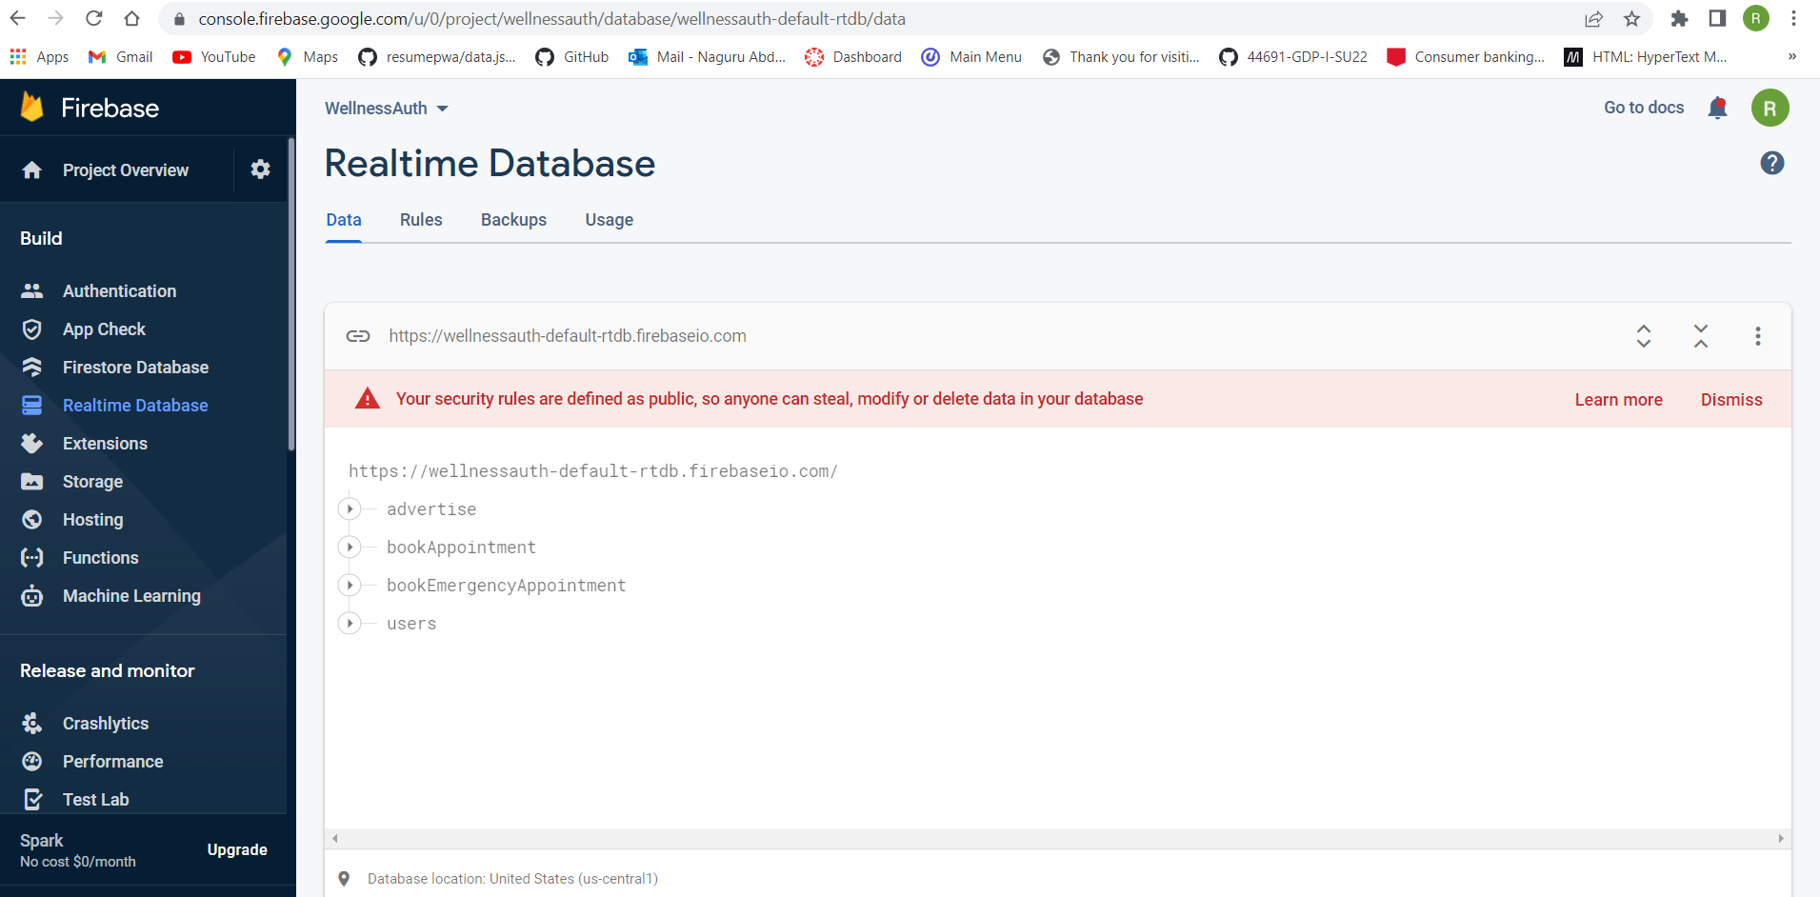
Stored Data in Realtime Database Simultaneously for future references and Stored Last Login date and time in real-time database
Firebase Realtime Database

Slide 14
Challenges Faced
First issue we faced with the project with react-router Dom → Installed the latest version in the project.
To store the appointment details in the database, initially we have used set(). This method overwrites the data. → Used update().
To read data from database, we used to get(). → We used snapshot.val().

Slide 15
Conclusion
Easy to Book Doctor Appointments
History records in your profile
Emergency Appointments

Slide 16
Research Paper – Social Robots in Health Care

Slide 17
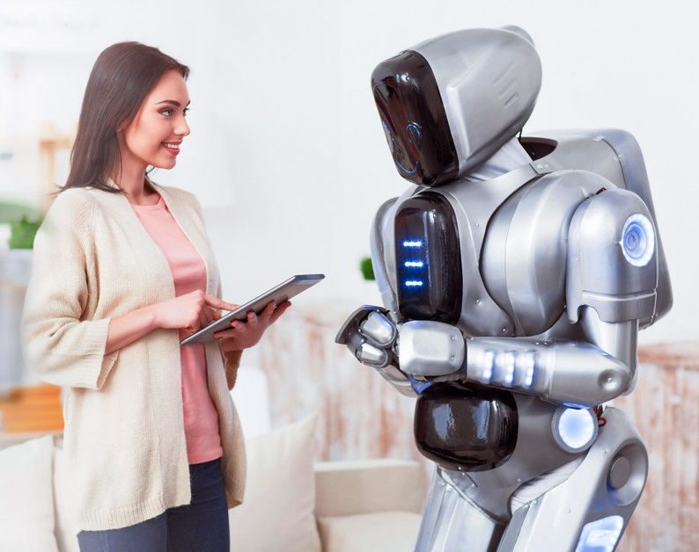
Robotics In Health Care
One estimate shows that a typical 200-bed hospital moves meals, linens, lab samples and other items the equivalent of 53 miles per day.
There enters an autonomous mobile robot that carry supplies to where they are needed.
Freeing employees from heavy physical loads and allowing them to focus on patient care.

Slide 18

Contents
Introduction On Social Robotics
Problem Statements
Hospital Environment
Robo path design
Script in Coppelia
Why Coppelia
Unity 3D
Zero sim
Gurobi
Software and Simulators Used.
Conclusion

Slide 19
Meal and Medicine Delivery to patients
Sanitization By the robots
Problem Statements
Notes:
Patients in the general ward need to get meals thrice a day.
Patients in the general ward need to get meals thrice a day.

Slide 20
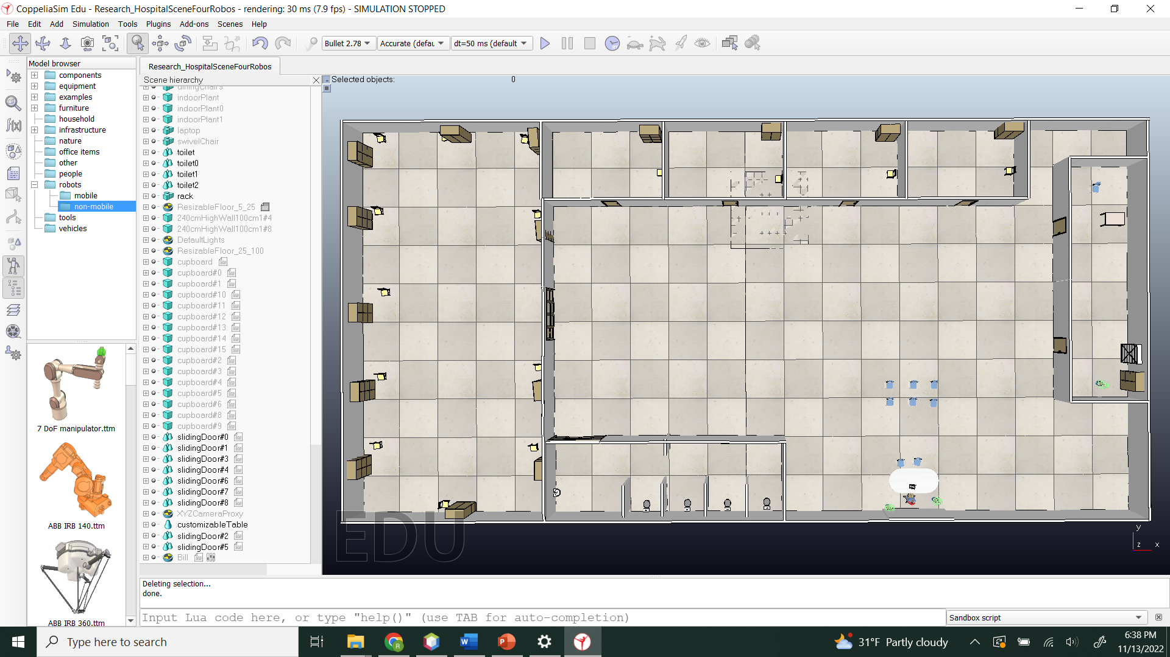
Hospital Environment in Coppelia Sim
Notes:
-> We used 240 cm high walls, cupboards, and doors.
-> here walls are static whereas cupboards and doors are non-static, we can program those non-static objects
-> we use Lua and Python programming languages for scripting these non-static objects.

Slide 21
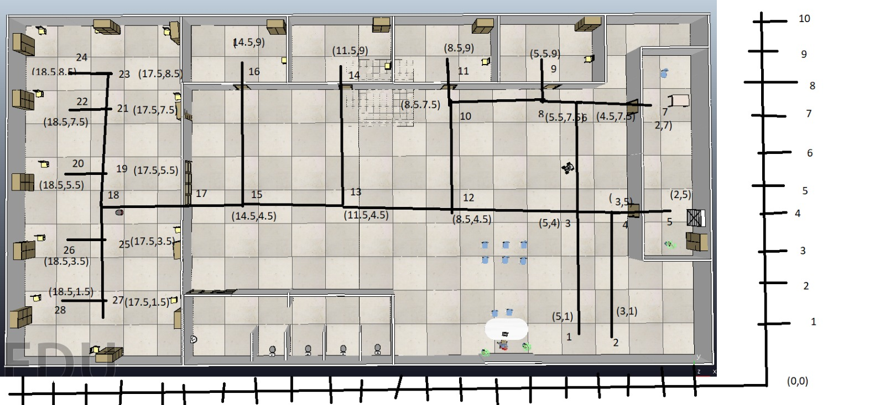
Robot Path Planning Graph
Hospital environment into Graph
Using the Distance formula in the Coordinate plane
Calculating the minimum distance and assigning those points of the path to the robot.
Notes:
->consider the hospital environment in a graph with the X and Y axis. It has coordinates for each and every point.
-> let us consider r1 and r2 are two robots, k1 is kitchen, ro1, ro1,ro3,ro4 are the rooms to delivery food.
-> we have multiple paths from the robot location to the kitchen and kitchen to rooms. Our approach will take the minimum distance for a particular room.
-> here we can use the formula for calculating all the costs of the distance: d=√((x_2-x_1)²+(y_2-y_1)²). Where x1, y1 are starting points and x2, y2 are destination points.

Slide 22
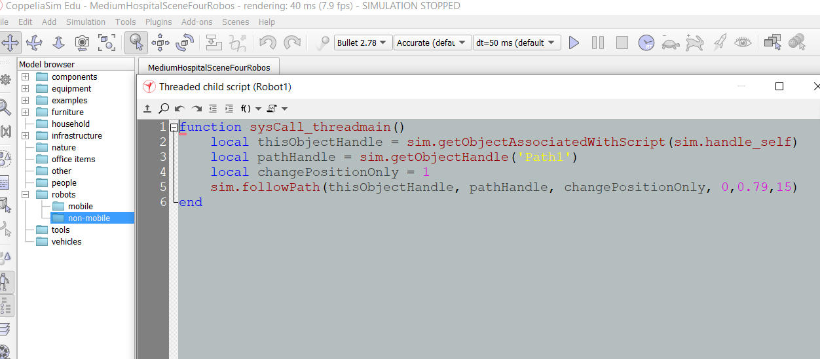
Script in Coppelia
Default function sysCall
Sim.getObjectHandle
Sim.follow path
Direction coordinates of robot
Notes:
function sysCall_threadmain()
// Default function name for robot child script where we have to write the code.
local this object handle = sim.getObjectAssociatedWithScript(sim.handle_self)
// Here we have a self, which means it will get the object by itself. If we mention this to the path it will get the object of the path
local pathHandle = sim.getObjectHandle('Path')
//this defines the robot to access the real Path, this function will get the object of the path and store in the variable “pathHandle”.
local change position only = 1
// this is the position of the robot. If you give 1, the only position is modified.
2, only orientation(direction of the body) is modified. 3, position and orientation are modified.
sim.followPath(thisObjectHandle, pathHandle, changePositionOnly, 0,0.17,15)
end
// this is the function that makes the robot follow the path. So far we know the first three parameters. Let us see the last 3 parameters.
4th parameter (0): this has an only values from 0 to 1. If you put 0, Robot will start from the beginning of the path. If you put 0.5, Robot will start from half of the path. If you put 1, Robot will directly display at the end of the path.
5th parameter (0.17): this is for the velocity of the robot if you increase the number, the speed of the robot will increase. 1 is a good number for the robot.
6th parameter(15): this is used for acceleration and declaration of the robot. Our program is running without this parameter also.

Slide 23
Why Did We Use Coppelia Simulator
→Coppelia Sim is a robot simulation environment used for the prototyping, development and verification of robot systems and algorithms.
→A robotic system can be a complex mechatronic system that is nontrivial to construct and use.

Slide 24

Softwares and Simulators Used
C/C++
Python
V-Rep
Microsoft Robotics Developer Studio
Gazebo
Notes:
The most popular language in robotics is probably C/C++. C++ is an object-oriented successor to the C language.
Python is also very popular due to its use in machine learning and because it can be used to develop ROS packages.
V-Rep was designed by Coppelia Robotics.

Slide 25

Other Tools Taken Into Consideration
Unity 3D
Zero Sim
Gourbi

Slide 26
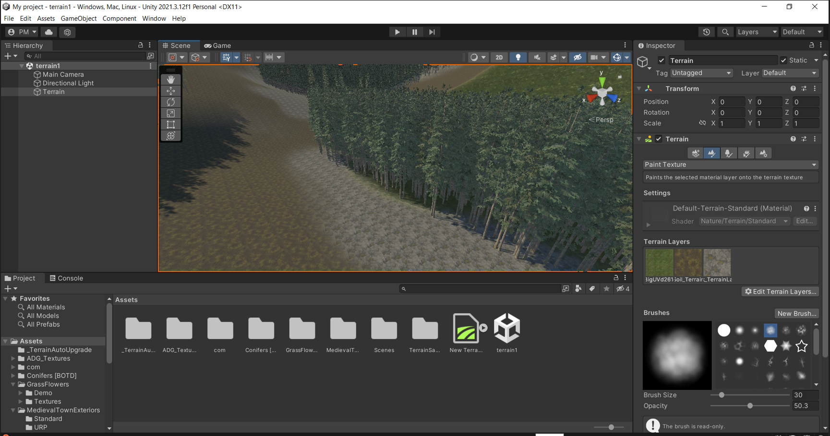
Unity 3D Intro

Slide 27

Components of the previous Image
Scene
Inspector
Hierarchy
Assets
Notes:
1. Scene- The previously shown scene was an example of a Mountain terrain with a path for hikers and mountain trees planted on the side. 2. Inspector-The Inspector window allows you to view and edit all the properties of the currently selected object. Since different types of objects have different sets of properties, the layout and contents of the inspector window will vary. 3. Hierarchy-Each item in the scene has an entry in the hierarchy, so the two windows are linked. The hierarchy defines the structure of how objects are attached. 4. Assets-A wide variety of Assets is available, covering everything from Models, Textures, and animations to whole Project examples, tutorials, and Editor Extensions. The assets are accessed from a simple interface created in the Unity Editor and are downloaded and imported directly into your project.

Slide 28
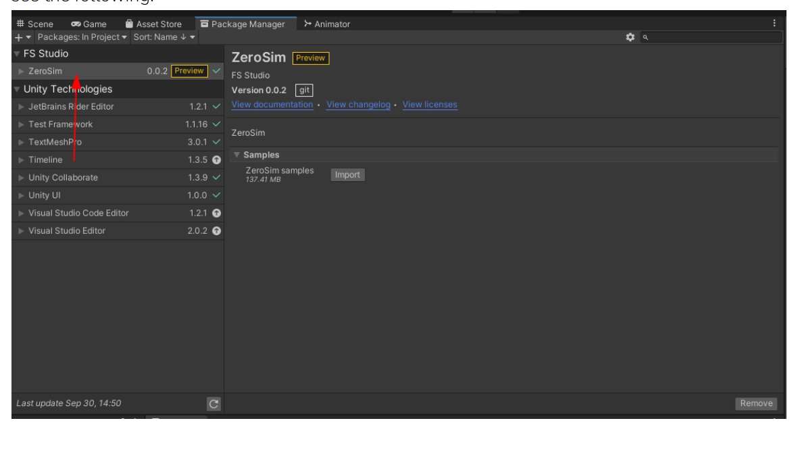
About ZeroSim
ZeroSim is a robotics simulation engine
ZeroSim is designed for ease of use and rapid development of all sorts of robotics
Notes:
ZeroSim is a robotics simulation engine built on the easy-to-use Unity 3D development platform and the power of the Robotics Operating System (ROS).
ZeroSim is designed for ease of use and rapid development of all sorts of robotics and simulation -- from warehouses and industrial settings, to farming and outdoors -- from robotic arms to ground and drone-based mobile robots.

Slide 29
Features of zero sim
Sensors (Stereo Camera).
Dynamics simulation.
ROS messaging communications.
Advanced 3D Rendering.
Notes:
-stimulate human binocular vision and capture 3 dimensional images.
-It is used to find time-varying behavior.
-It is imp part for robotics application,it will state the info of all nodes.
-Animation, process of creating an image using computer software

Slide 30
Gurobi
It is a software you can interface through various languages like Python, R etc.,
Machine learning also serves the same purpose as Gurobi
You can create mathematical models.
Pre requirements
Anaconda
Jupyter Notebook
Notes:
You input what you want to achieve, and Gurobi identifies your best set of decisions. And if something changes along the way, no problem! Just adjust your inputs and run it through Gurobi again.
Machine learning also serves the same purpose, but the difference is with Gurobi, you can make decisions that don’t rely on your past data

Slide 31
Conclusion
Robots that can efficiently disinfect hospitals.
Meals can be served in an organized manner.
Manual effort will be reduced.
Notes:
Robots that can efficiently disinfect hospitals using UV light could slow coronavirus infections and automatically disinfect the air and surfaces of hospital environments can help reduce the human resources spent on environmental cleaning.
Meals can be served in an organized manner so that patients can have food on time.

Slide 32

Thank you
Any Queries?

